Slide 1
Single Table Queries
Week 2 Chapter 4 Video 4
DISTINCT – WHERE
Dr. Anne Powell

Slide 2
Agenda
1. Basic SELECT commands
2. Column Formatting
3. Common Errors
4. WHERE - DISTINCT commands
5. ORDER BY command
6. In-class practice

Slide 3
SQL – WHERE Clause
This SELECT statement only selects specific fields (SSN and FirstName).
The WHERE clause specifies a single SSN.
/* SQL Example WHERE clause */
SELECT SSN, FirstName
FROM Employee
WHERE SSN = '215243964';
SSN FIRSTNAME
--------- ---------------
215243964 Douglas

Slide 4
WHERE - Character Data
Comparison operators can be used with columns containing character data.
Literal character strings and dates must be enclosed with single quotation (' ') marks.
/* SQL Example */
SELECT EmployeeID, LastName, FirstName
FROM Employee
WHERE Gender = 'M';
EMPLOYEEID LASTNAME FIRSTNAME
---------- --------------- ---------------
67555 Simmons Lester
33344 Adams Adam
33358 Thornton Billy
more rows will be displayed…

Slide 5
WHERE – Numeric Example
COLUMN Salary FORMAT $99,999.99
COLUMN LastName FORMAT A15;
COLUMN FirstName FORMAT A15;
SELECT EmployeeID, LastName, FirstName, Salary
FROM Employee
WHERE Salary >= 25000;
EMPLOYEEID LASTNAME FIRSTNAME SALARY
---------- --------------- --------------- -----------
88303 Jones Quincey $30,550.00
88404 Barlow William $27,500.00
88505 Smith Susan $32,500.00
3 rows selected
NOTE: Do not use the $ symbol, comma, or single quotes when specifying a numeric, currency condition.

Slide 6
Comparison Operators
Operator Meaning
= equal to
< less than
> greater than
>= greater than or equal to
<= less than or equal to
!= not equal to
<> not equal to
!> not greater than
!< not less than

Slide 7
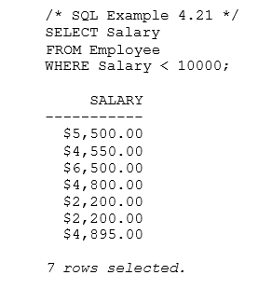
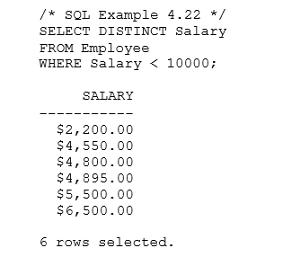
DISTINCT Clause
The DISTINCT clause eliminates duplicate rows in a result table.
DISTINCT must be specified prior to any column names.
a
NOTE: If you format a column once in a query, any subsequent query (UNTIL you log out) will retain that formatting. In this example, a prior query had formatted Salary to COLUMN Salary FORMAT $99,999.99;

